Slide 1
Extragalactic Astrophysics and Cosmology Group Study 2013
Predictions Group Seminar

Slide 2
Our Aims:
To be able to predict the number of galaxies present during the epoch of Cosmic Reionization.
To calculate the number of UV photons available to re-ionize the neutral hydrogen in the IGM in order to obtain an estimate for the redshift range of this epoch.

Slide 3
How we have done this:
Found a general Schechter Function in terms of magnitudes.
Built a program to automate process of calculating number of galaxies using this Schechter Function.
Found plausible starting parameters.
Determined parameter evolution with time.
Incorporated most likely parameter evolution into program.
Determined how cosmic variance affects the number of galaxies.
Incorporate cosmic variance and clustering into the program.
Plotted results to display data in a more ‘user friendly’ way.
Give an estimate of number of galaxies to the observers.
9. Written separate program to obtain estimate of the number of UV photons available to ionize the neutral hydrogen in the IGM.
10. Used this number to estimate the redshift range for the epoch of Cosmic Reionization.

Slide 4
What else needs to go in:
Jamie: schechter function- what it is and why we used it (very brief).
Owen and Andy: briefly how the programs do this and why we have 2, initial results?
Josh: assumptions and parameters/ evolution with time- graph of different ones and which we have chosen (preferably on same plot?) and why.
Owen and Andy: how this changed results.
Lewis: cosmic variance and clustering- what they are and how they affect number of galaxies and briefly how to include it.
Owen and Andy: how cosmic variance affected results- quote results? Any graphs?
Jamie/ Beth: star formation rates, how we calculated, why we calculated, what limit does this put on the redshift? What numbers did we get for number of ionizing photons?
Beth: summary of final values: number of galaxies (include magnitude and redshift range for completeness) and number of ionizing photons and hence redshift range.
If we manage to work out this jeans mass for galaxies to form (I think that was Owen) then that will be included perhaps before star formation rates.

Slide 5

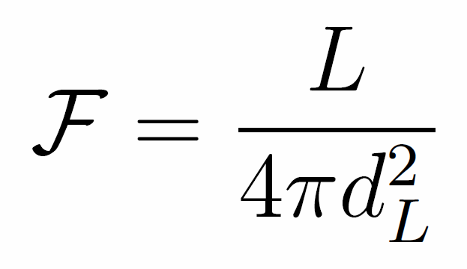
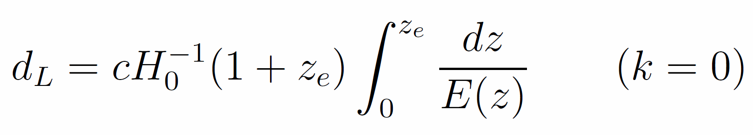
Cosmological Distances
Co-moving Distance
Luminosity Distance
Magnitude Conversion
Notes:
dH (hubble distance) radius of the visible universe. Luminosity distance is redshifted. Magnitude conversion is for AB system. Get volume from comoving volume.

Slide 6

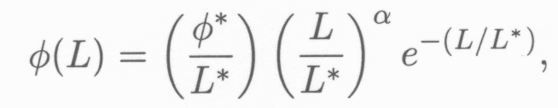

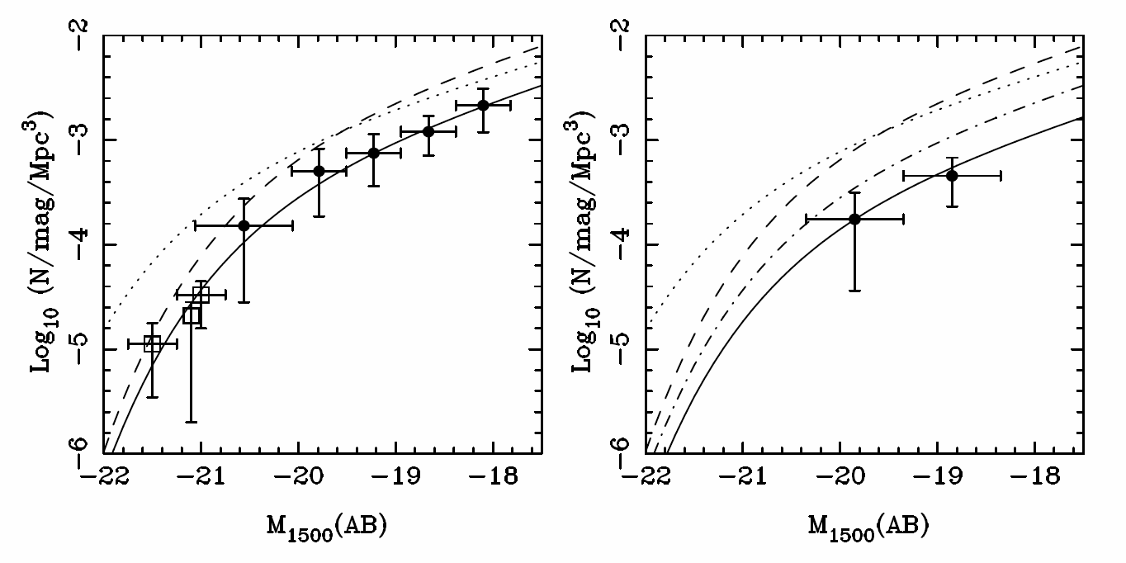
Schechter Function
Z=7
Z=8
(McLure, 2010)

Slide 7


Schechter Function
Number Density:
Luminosity Density:

Slide 8
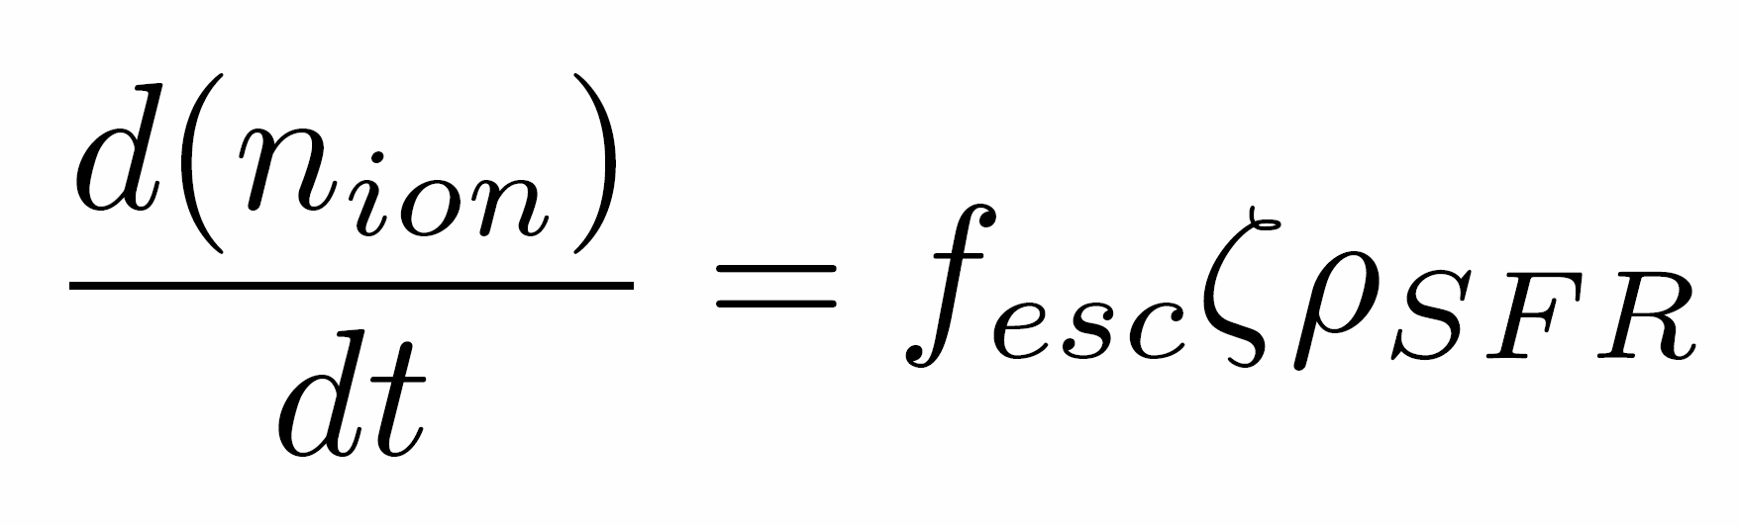
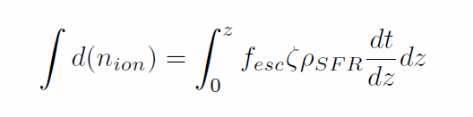


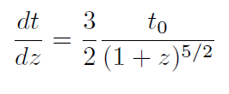
Star Formation Rate
(Kennicutt 1998)
Where assuming matter dominated epoch,

Slide 9
Assumptions
Universe is:
Flat
Matter Dominated
No cosmic variance (to begin with)
Constant Schechter Function
Parameters of the Schechter function do not change as a function of redshift.

Slide 10
Schechter Function
Next step is to add variation in the parameters of the Schechter Equation as a function of redshift.
Involve using real data from observations
Extrapolate backwards for higher redshift
Try different fits for data.

Slide 11
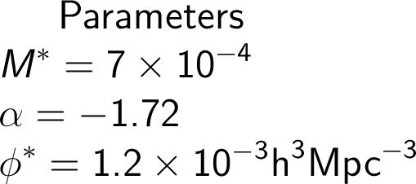
Parameters
Parameters taken from papers on high redshift galaxies.
Started with constant values, moved on to parameter evolution with redshift.

Slide 12
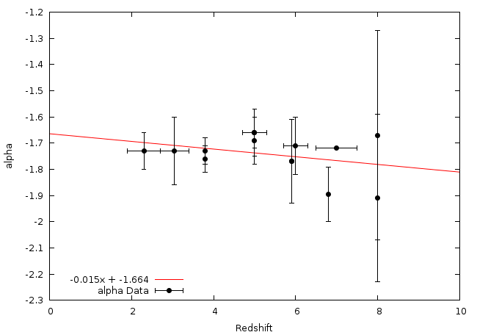

alpha Evolution - Linear

Slide 13
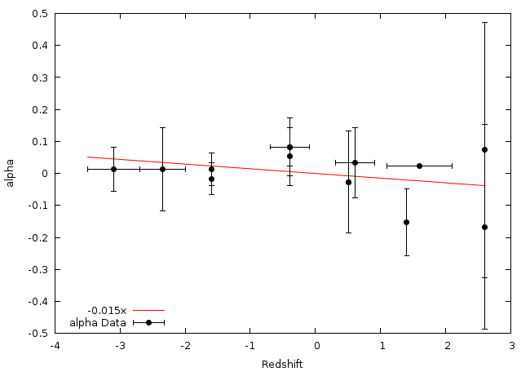
alpha Evolution - Pivot

Slide 14
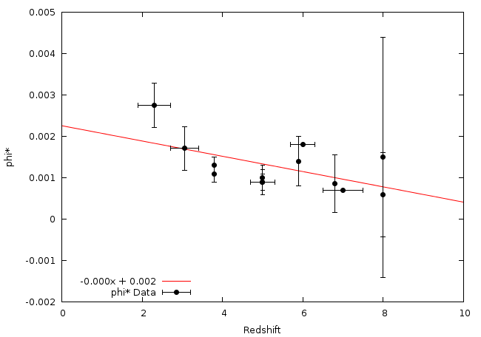
phi* Evolution - Linear

Slide 15
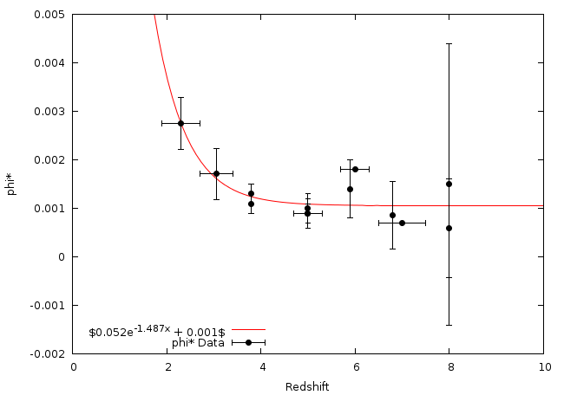
phi* Evolution - Exponential

Slide 16
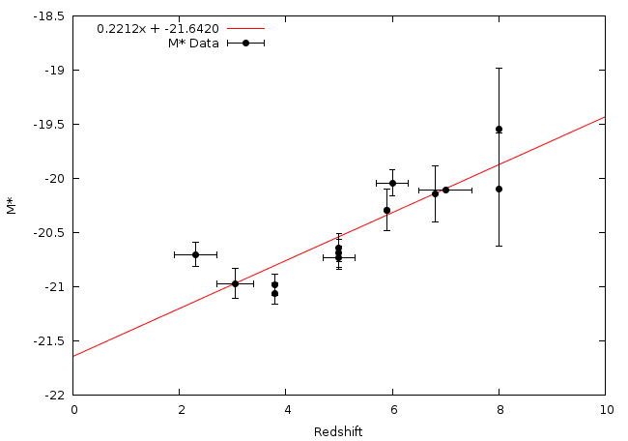
M* Evolution - Linear

Slide 17
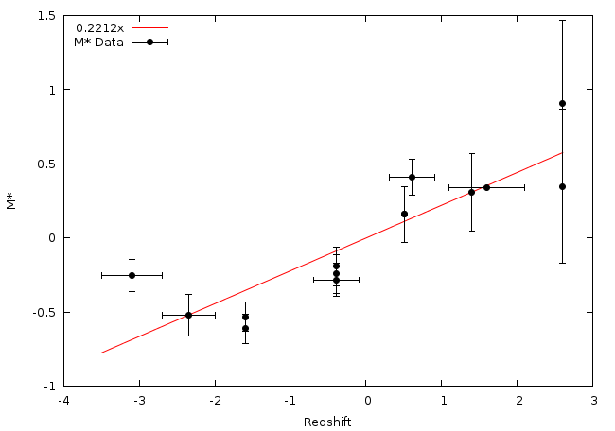

M* Evolution - Pivot

Slide 18
The Programs
We have created two programs designed to compute the same quantities in slightly different ways in order to validate any results we obtain.
These have been predominantly written by Owen and Andy.

Slide 19
Schechter Function Computation
Main aims: To give the observing group appropriate inputs, and to compare results with other code.
Results: Appropriately shaped Schechter function graph upon output, and a number of galaxies outputted, within apparent magnitude range.

Slide 20
Future Aims
Attempt to match outputted number with observed data at a variety of redshifts and apparent magnitudes
Get program to output effectively
Calculate Ionizing photon rate density from Schechter Function.
Integrate graphing function with code.
Parameters evolving with redshift.

Slide 21
Schechter function output

Slide 22
Plans for improvement
Converging time analysis to optimise accuracy for a given computation time.
Implement upper and lower bounds on parameter evolution
Output distributions
Create intuitive input system

Slide 23
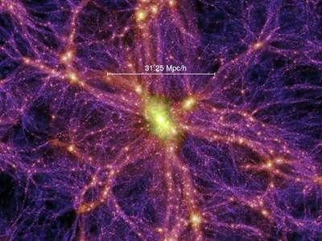

Cosmic Variance
Statistical uncertainty in any cosmological observation brought about by large-scale cosmic structure.
The Universe is only homogeneous at the largest scales (>1Gpc).
Any number or density measurement derived from a galaxy population is susceptible to Cosmic Variance.
This will be the dominant source of error, well in excess of Poisson noise.
Any cosmic survey should take account of Cosmic Variance.
Given by:

Slide 24
Including Cosmic Variance in the code
Any estimates produced for the observing team, from the code, should account for Cosmic Variance in some way.
The Cosmic Variance of a survey depends on:
Total survey volume.
Aspect ratio - lower for higher aspect ratio surveys.
Number of sightlines - empirically reduced with multiple sightlines, by √N – where N is the no. of sightlines.

Slide 25
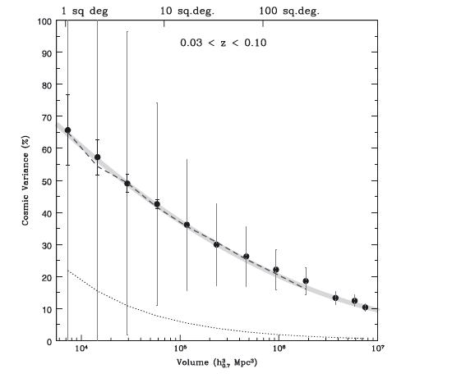

Slide 26
Summary:

